Slide 1
The Fate of the Berlin Jewish Health Insurance Doctors under National Socialism.
1933 - 1945
Dr. Susi Williams

Slide 2
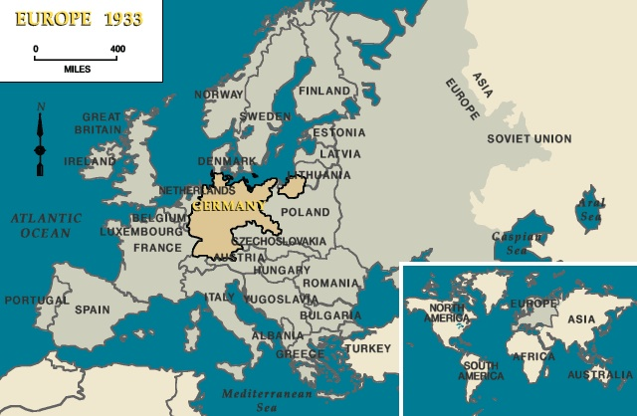

Slide 3
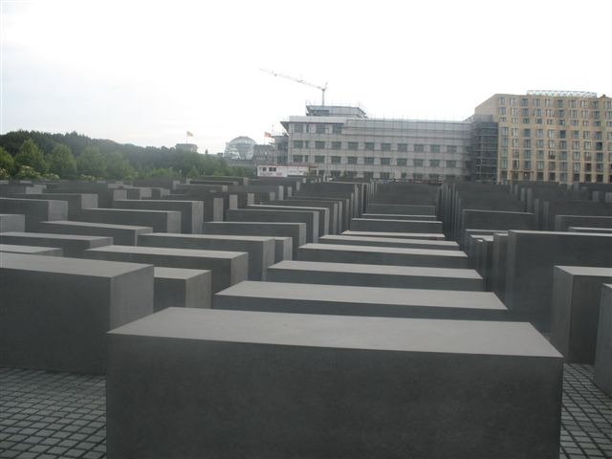
Berlin Memorial

Slide 4
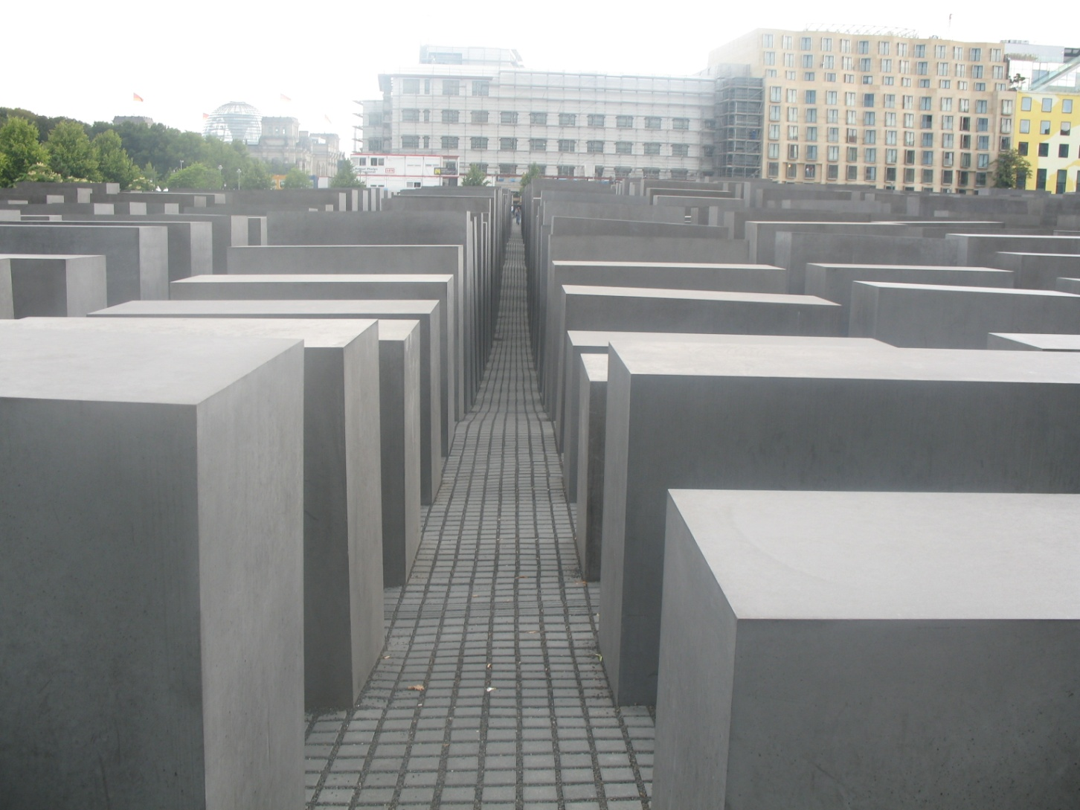
Holocaust Memorial

Slide 5
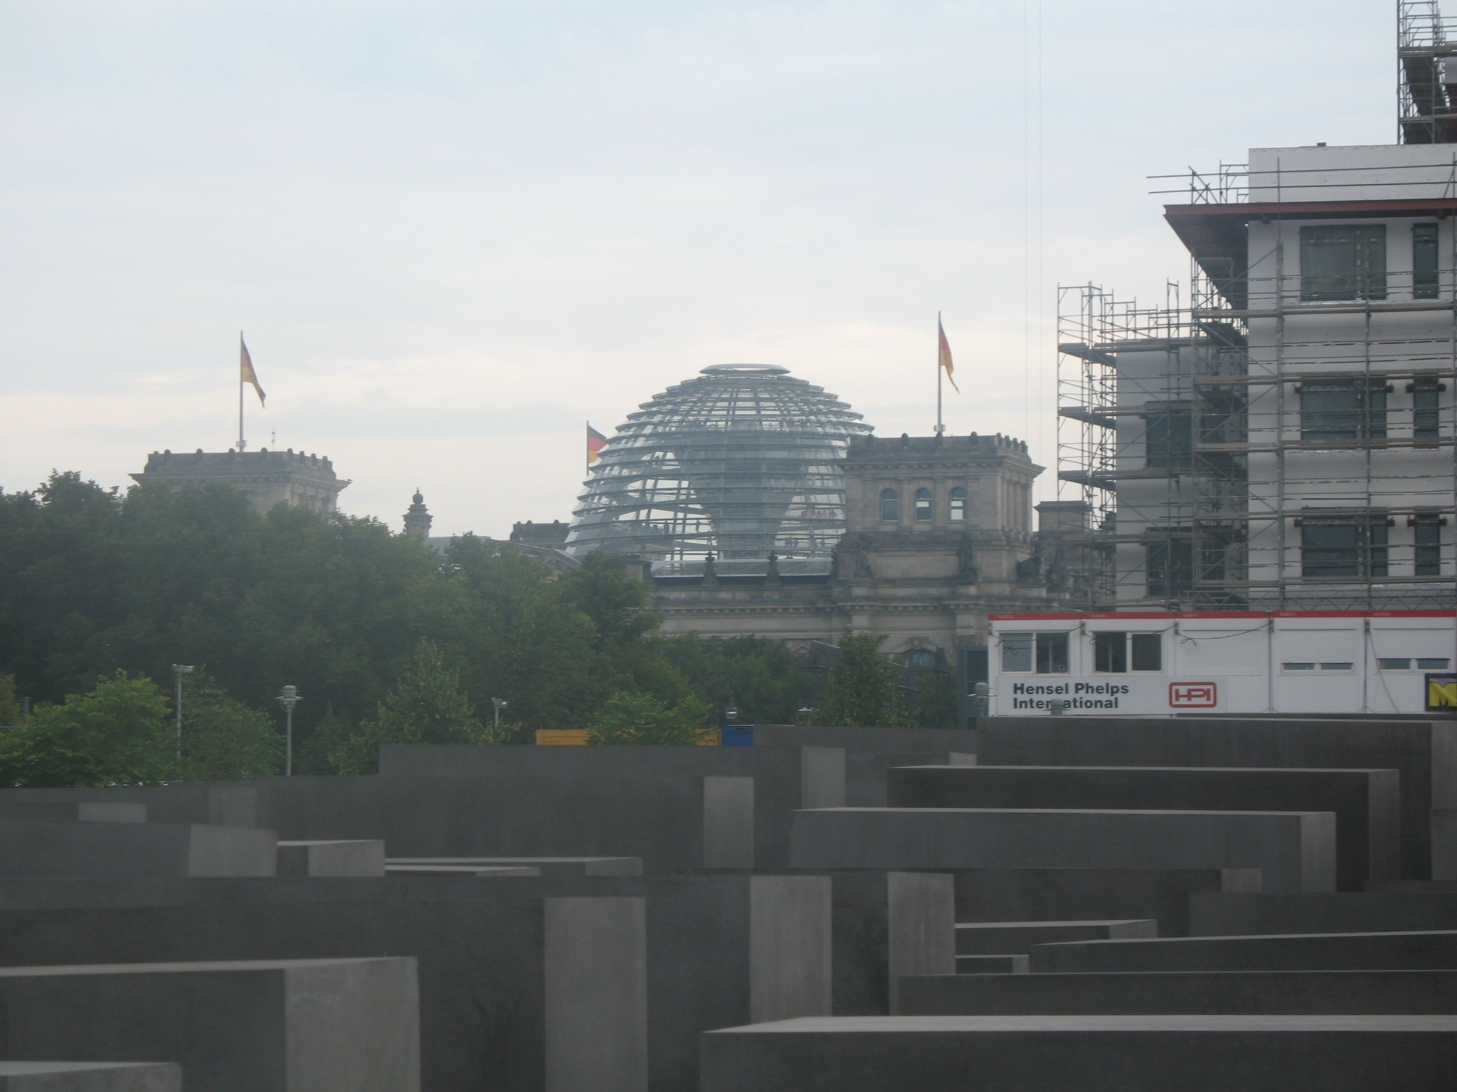

Slide 6
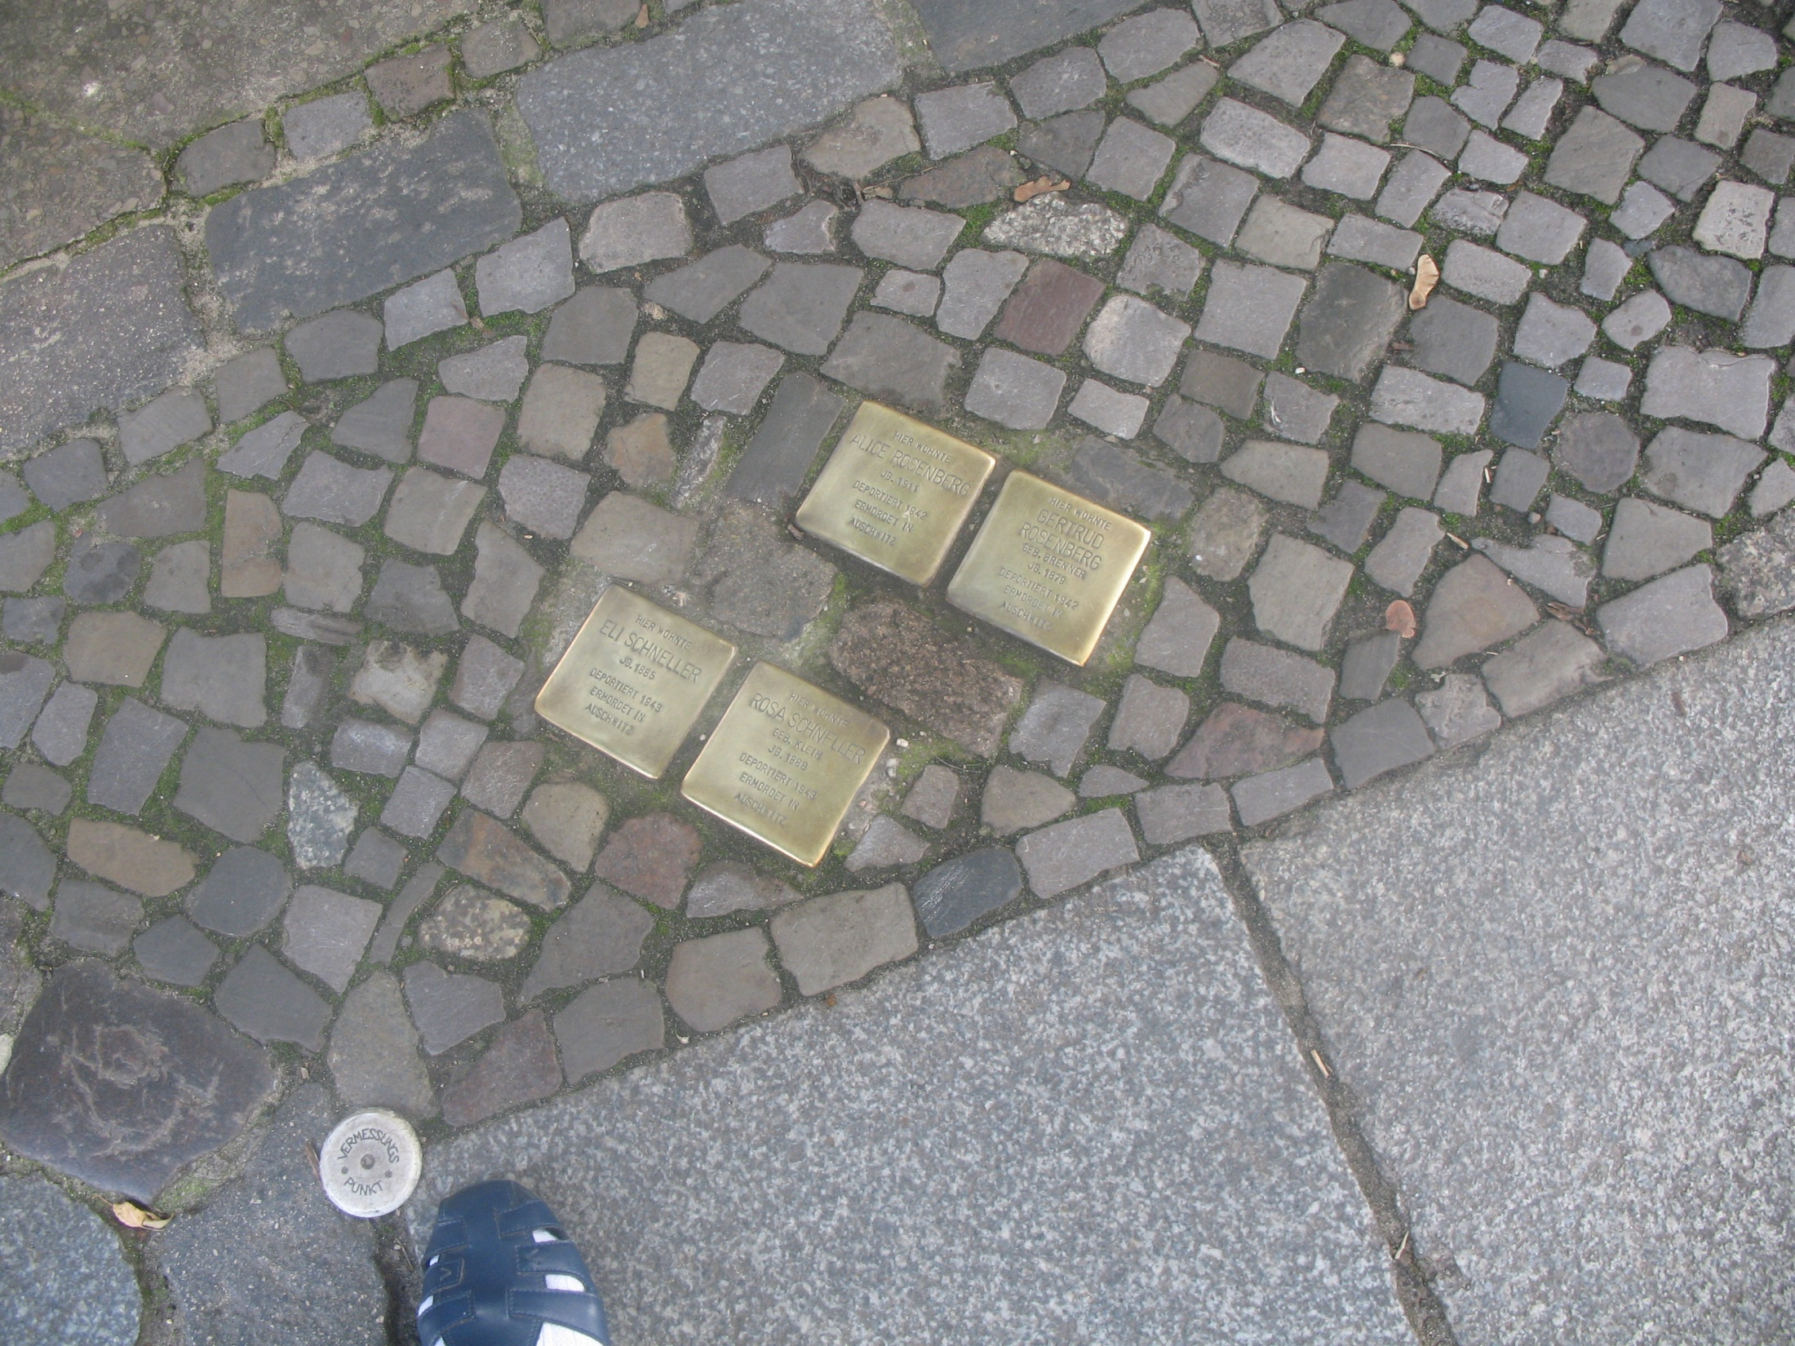
Stolpersteine Name, date of birth, date of deportation, murdered in Auschwitz.

Slide 7
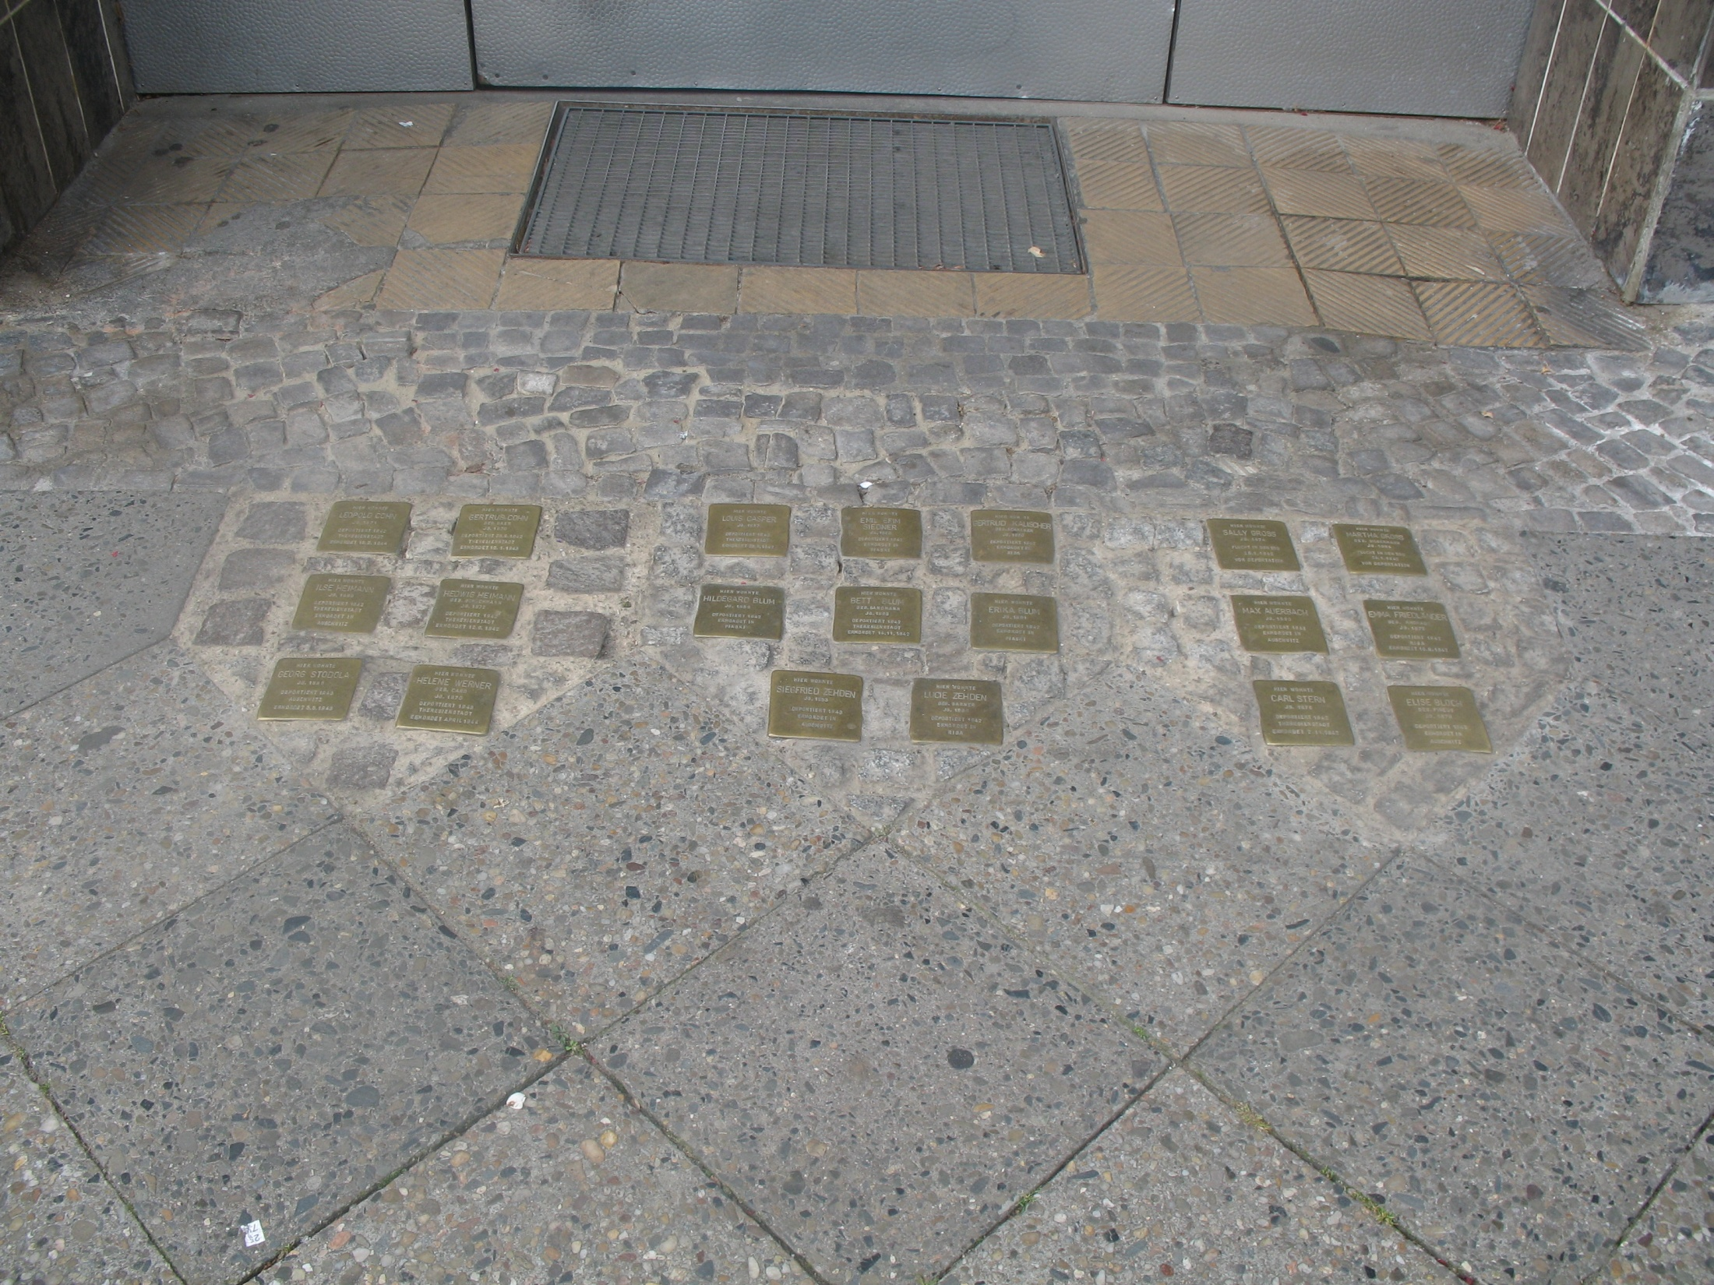

Slide 8

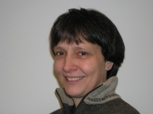
Dr. Rebecca Schwoch

Slide 9
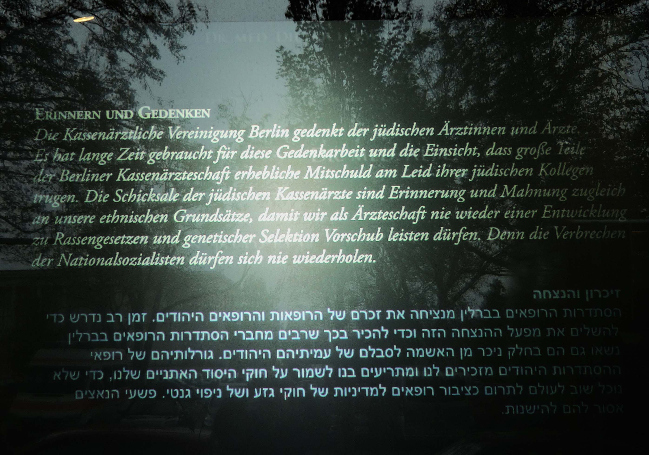

Slide 10
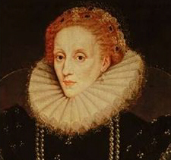
Queen Elizabeth 1
Her private Physician Rodrigo Lopez, a Marrano, was arrested and accused of treason. He was hung drawn and quartered in 1597.

Slide 11


Slide 12


Slide 13
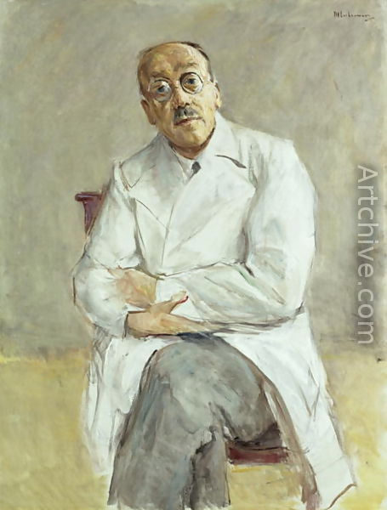
Professor Ferdinand Sauerbruch
Painted by Max Lieberman 1932
Notes:
Painted by Max Lieberman in 1932

Slide 14
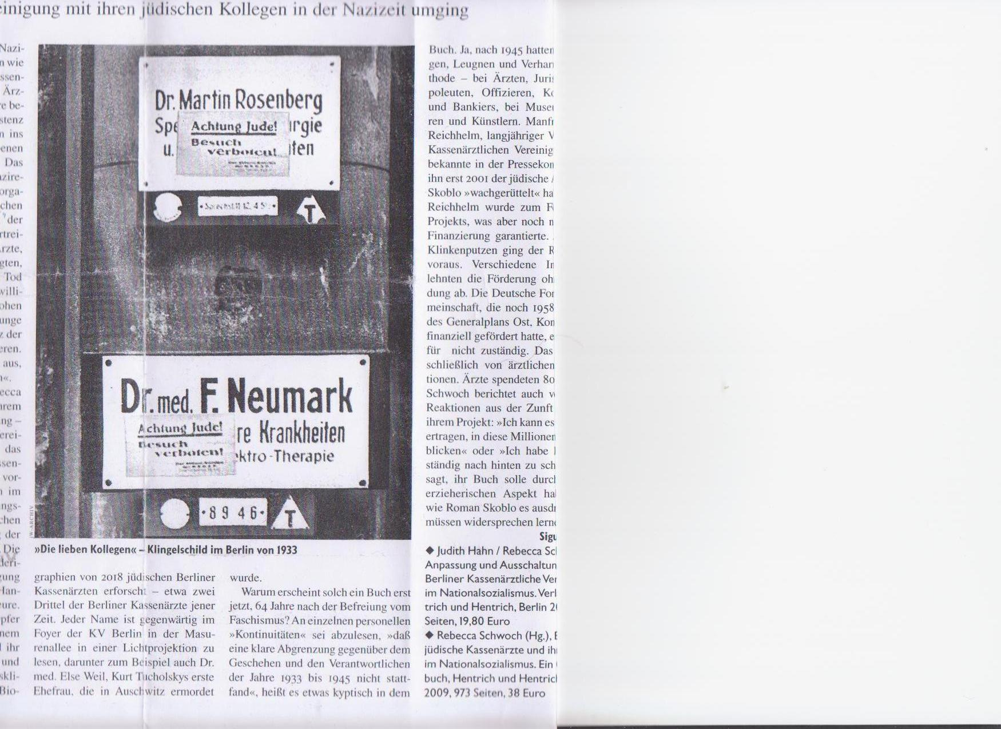

Slide 15
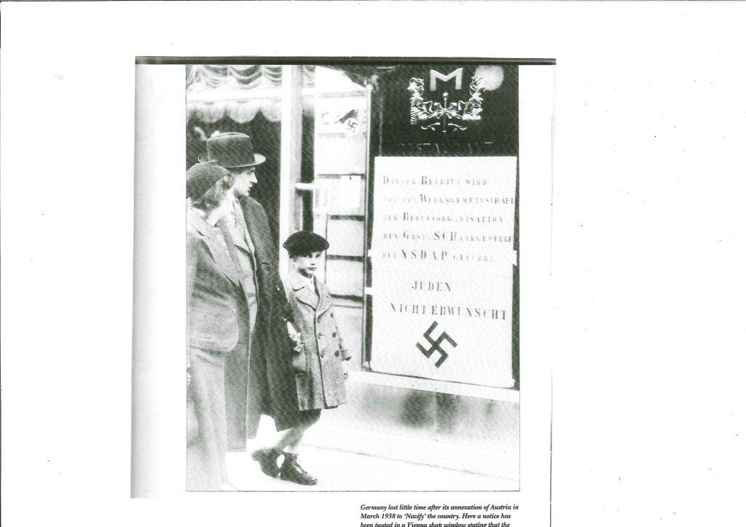

Slide 16
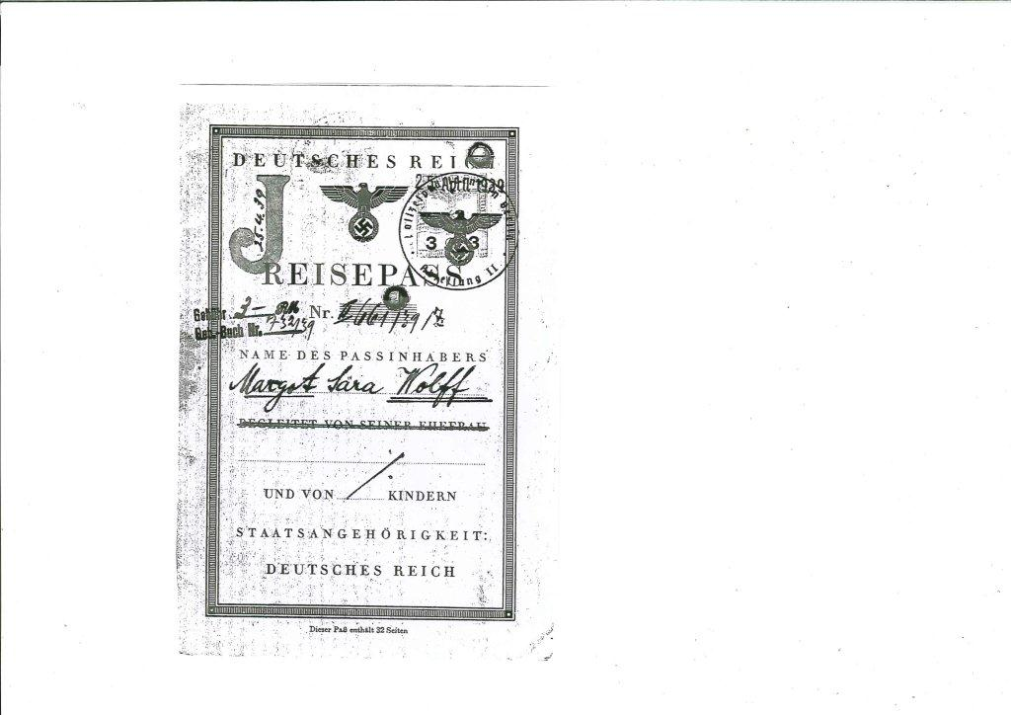

Slide 17
Interview with Dr. Sternberg
When he was interviewed by a Dominion reporter on December 24th 1934 on his arrival at Wellington on the Rangitata with his wife and small son, Dr. Alfred Sternberg stated that 500 medical men had left Germany already because of Hitler’s policies. 100 had gone to Edinburgh, 200 to Palestine and the rest to France and Switzerland. He had passed the Edinburgh examinations and could work as a doctor in New Zealand.

Slide 18
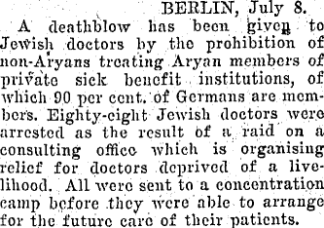
Evening Post 10th July 1933. Volume CXVI Issue 8
Notes:
Evening Post, Volume CXVI Issue 8 10th July 1933 page 7

Slide 19

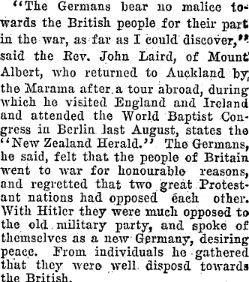
Evening Post 6th October 1934
Notes:
Evening Post 6th October 1934

Slide 20
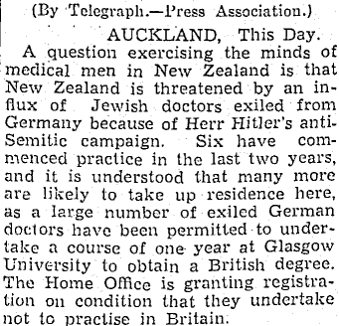
Evening Post 27th July 1937
Notes:
Evening Post, 27th July 1937

Slide 21
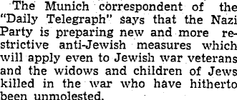
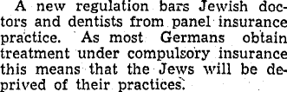
Evening Post January 1938, the remaining Jews are “even more restricted”
Notes:
Evening Post, January 4, 1938

Slide 23
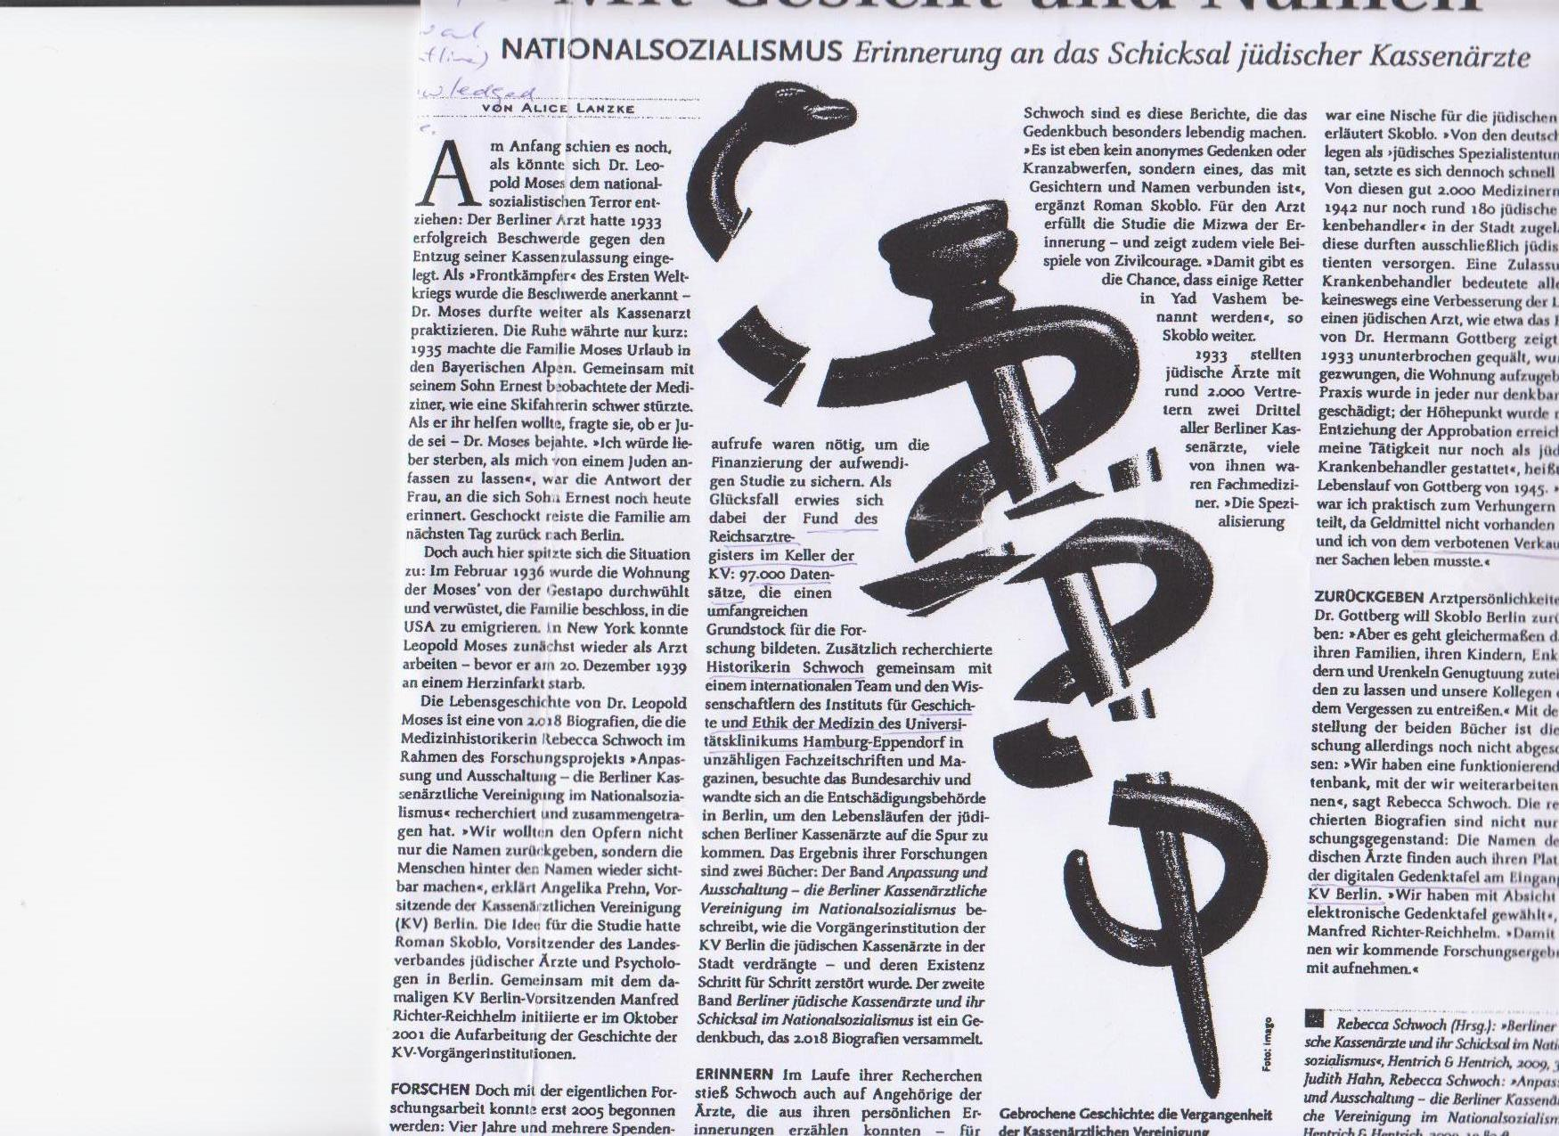

Slide 24


Slide 25
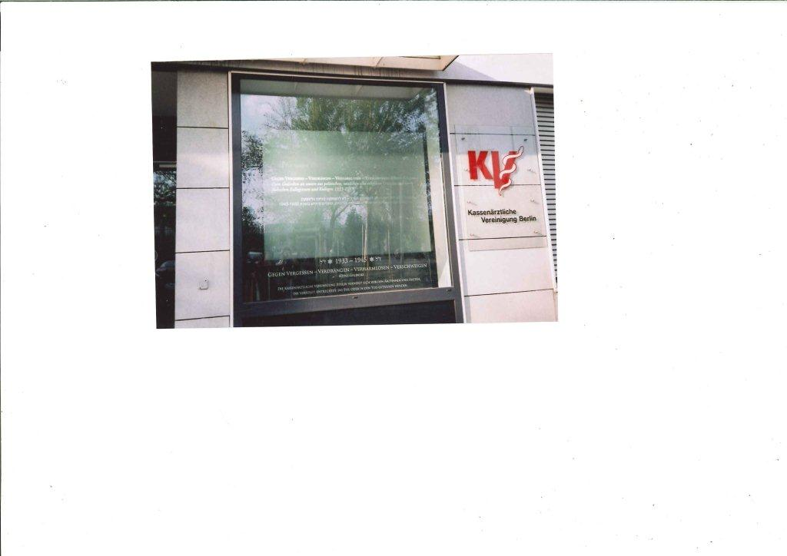

Slide 26
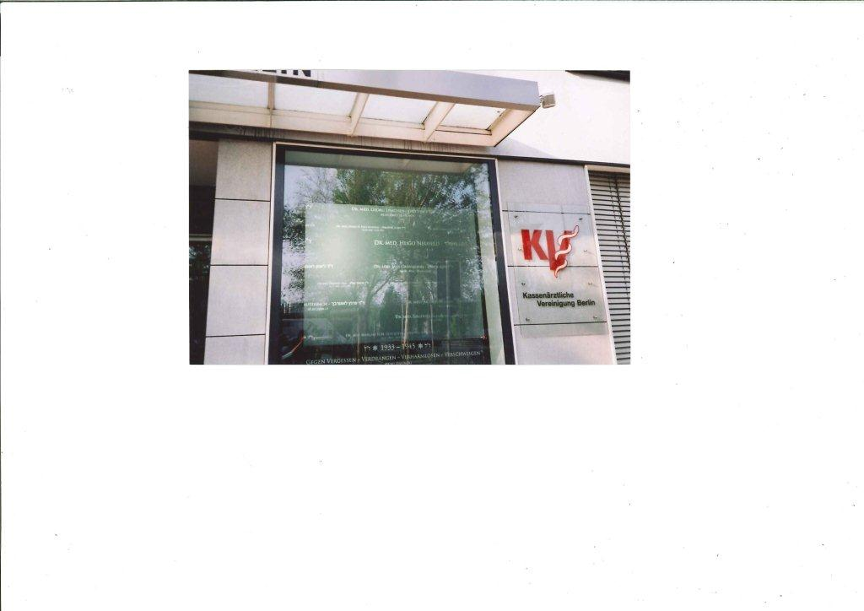

Slide 27
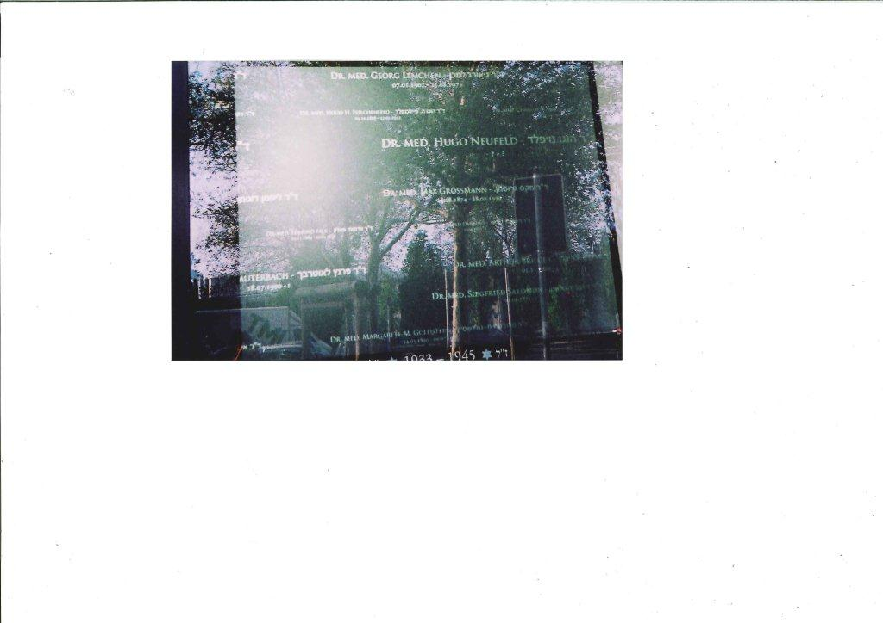

Slide 28
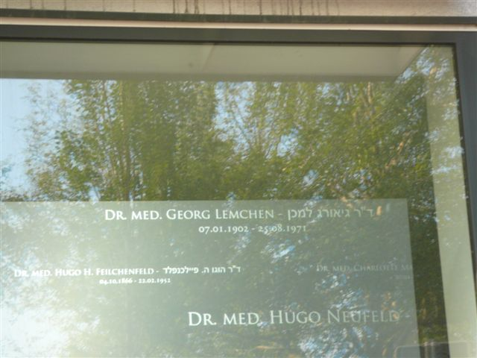

Slide 29
Holocaust Centre of New Zealand
80 Webb Street, Wellington, New Zealand.
Phone 64 – 4 – 801 9480
www.holocaustcentre.org.nz

Slide 30
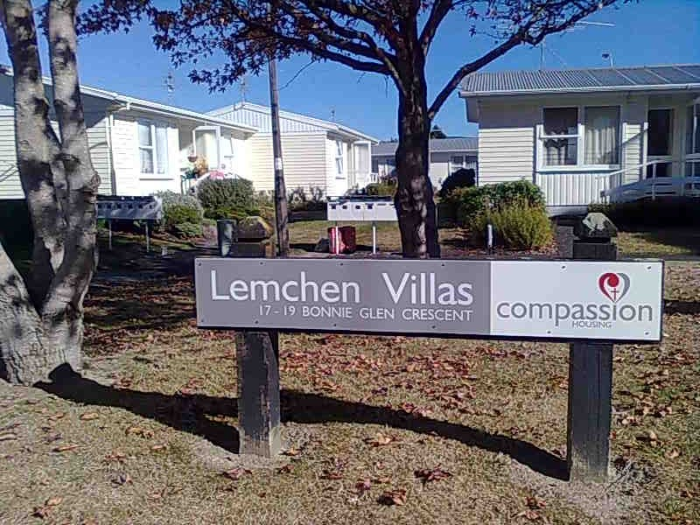

Slide 31


Slide 32
. GENOCIDE AS DISEASE DIAGNOSTIC CRITERIA
**A Culture that does not place a high price on human life
**A totalitarian society, with its assumed superior ideology
**Potential victims portrayed as less than fully human
**Strong centralized authority and bureaucratic organization
**Pathological individuals and criminals
From M. Hassan Kakar
Professor at Kabul University and Scholar of Afghanistan Affairs at time of 1978 coup d’etat.

Slide 33
