Slide 1
Omnipotent Doctor to Multidisciplinary Team.
What happened ?
Has it made any difference to Patient Care?
Dr. Susi Williams December 2014

Slide 2
HISTORY
Study of past events, especially human affairs
Eventful past career

Slide 3
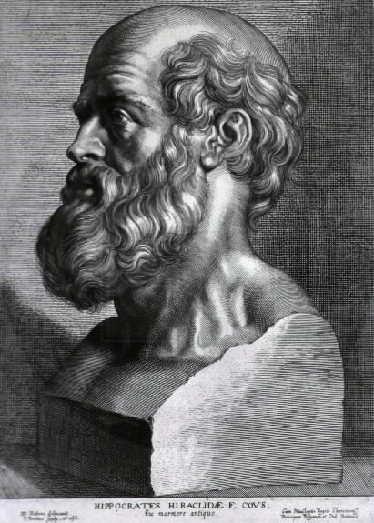

Slide 4
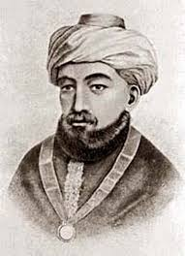

Slide 5
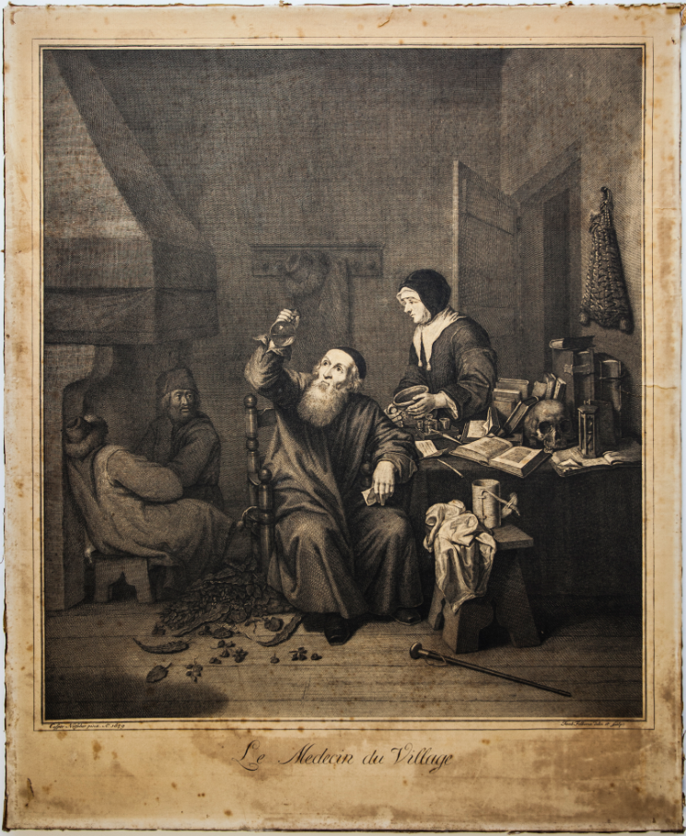

Slide 6
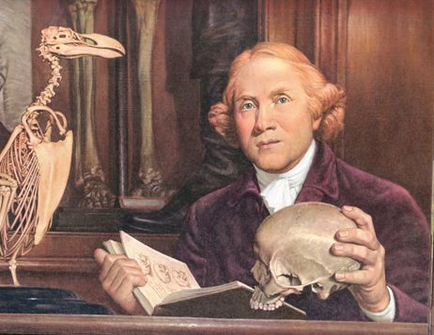
John Hunter Scottish Surgeon 1728-93

Slide 7
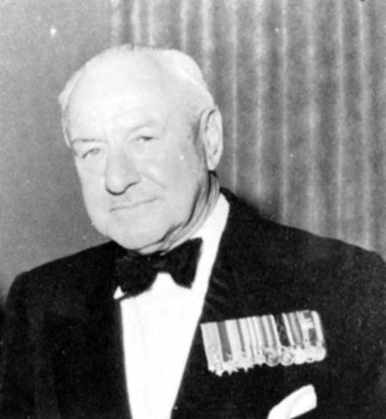
William Henry Blinman BULL CBE FRCS FRACS

Slide 8
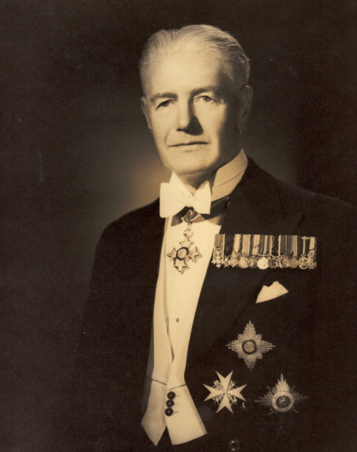
Sir Frederick BOWERBANK OBE KBE KNIGHT of GRACE ST. JOHN

Slide 9
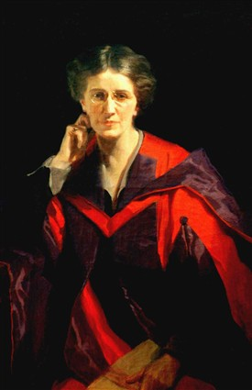
Dr. Louisa Martindale Physician Surgeon Writer Magistrate and member NCW

Slide 10
“I solemnly declare that, as a Graduate in Medicine of the University of New Zealand, I will exercise my profession to the best of my knowledge and ability for the good of all persons whose health may be placed in my care and for the public weal.
I will respect the secrets which are confided in me and maintain the utmost respect for human life. I will hold in due regard the honourable traditions of and obligations of the medical profession and do nothing inconsistent therewith and I will be loyal to the University and endeavour to promote its welfare and maintain its reputation.”

Slide 11
The Oath of Maimonades
Has been attributed to him but may have been written by Herz a German physician, who wrote it down much later.

Slide 12
The Declaration of Geneva
(Physician’s Oath)
Adopted by the General Assembly of the World Medical Association at Geneva in 1948
Amended 1968,1983,1994 and editorially revised in 2005 and 2006

Slide 13
The Nightingale pledge
Based on the Hippocratic Oath.
It was used first in 1893
Amended in 1935

Slide 14
Changes in the past 50 Years
MANY
and the increasing reliance on the TEAM

Slide 15
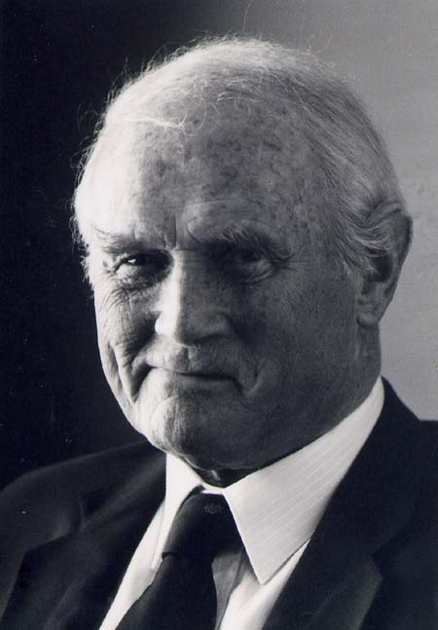
Dr. Keith Wallace Cochrane Superintendent
Wellington Hospital

Slide 16
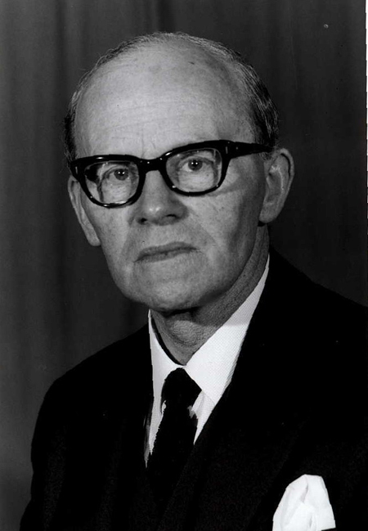

Slide 17
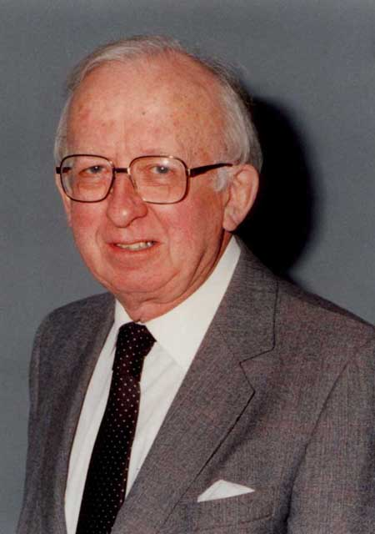
Dr. Caleb Lewis Tucker
Superintendent in Chief Wellington Hospital Board

Slide 18
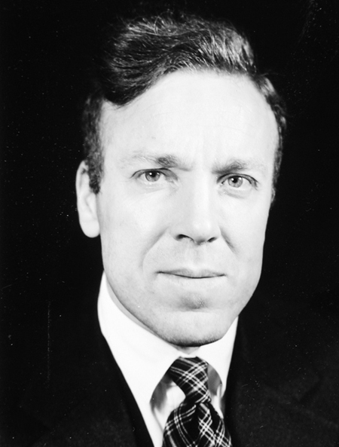
Dr. James Verney Cable

Slide 19
Journal of Royal College of Physicians
Clinical Medicine Vol 14 No 3 dated 3/6/14
discusses the working of a multidisciplinary team when sorting out who should have a PEG inserted.

Slide 20
Paper written by Gemma Clarke Research associate; Sarah Galbraith Consultant in Palliative Care; Jeremy Woodward Gastroenterologist; Anthony Holland University Chair of Health Foundation; Steven Barclay University Lecturer GP and Palliative Care.
“A multidisciplinary team meeting provides a crucial space for clinicians to come together and discuss the wider issues involved, in detail and in depth.”
This particular team was chaired by the Consultant in Palliative Medicine but include gastroenterology staff, geriatric staff, speech therapists, dieticians , clinical nurses, endoscopy nurse and the patient’s primary care nurse.

Slide 21
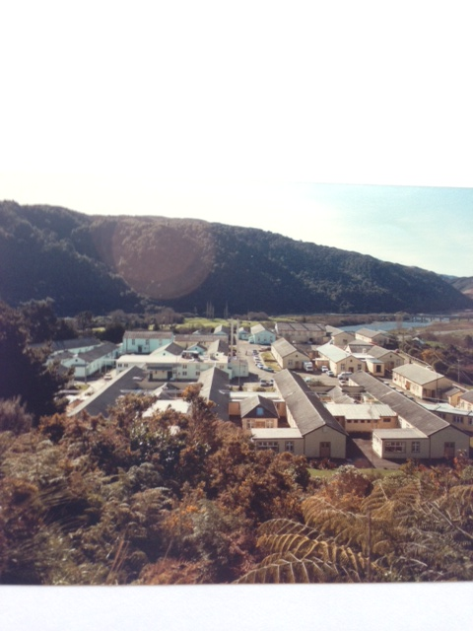
Silverstream Hospital

Slide 22
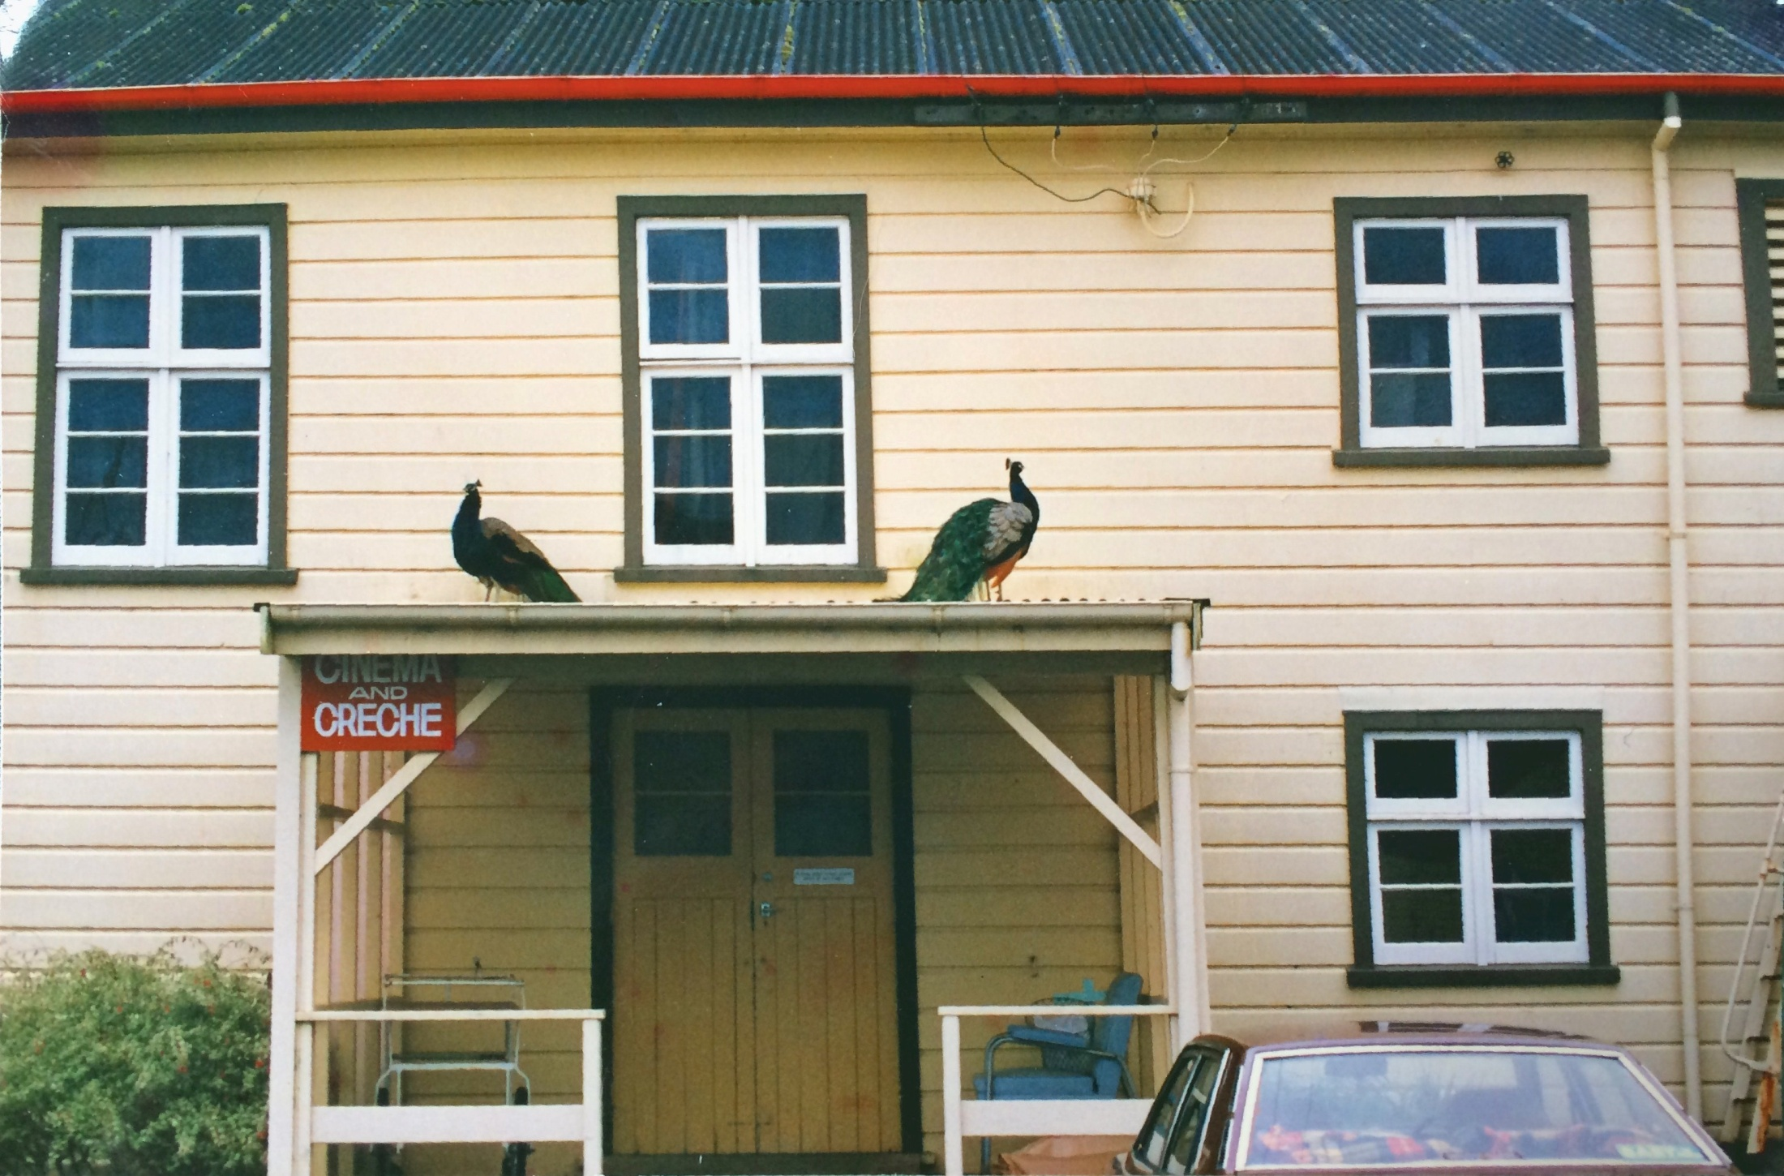

Slide 23
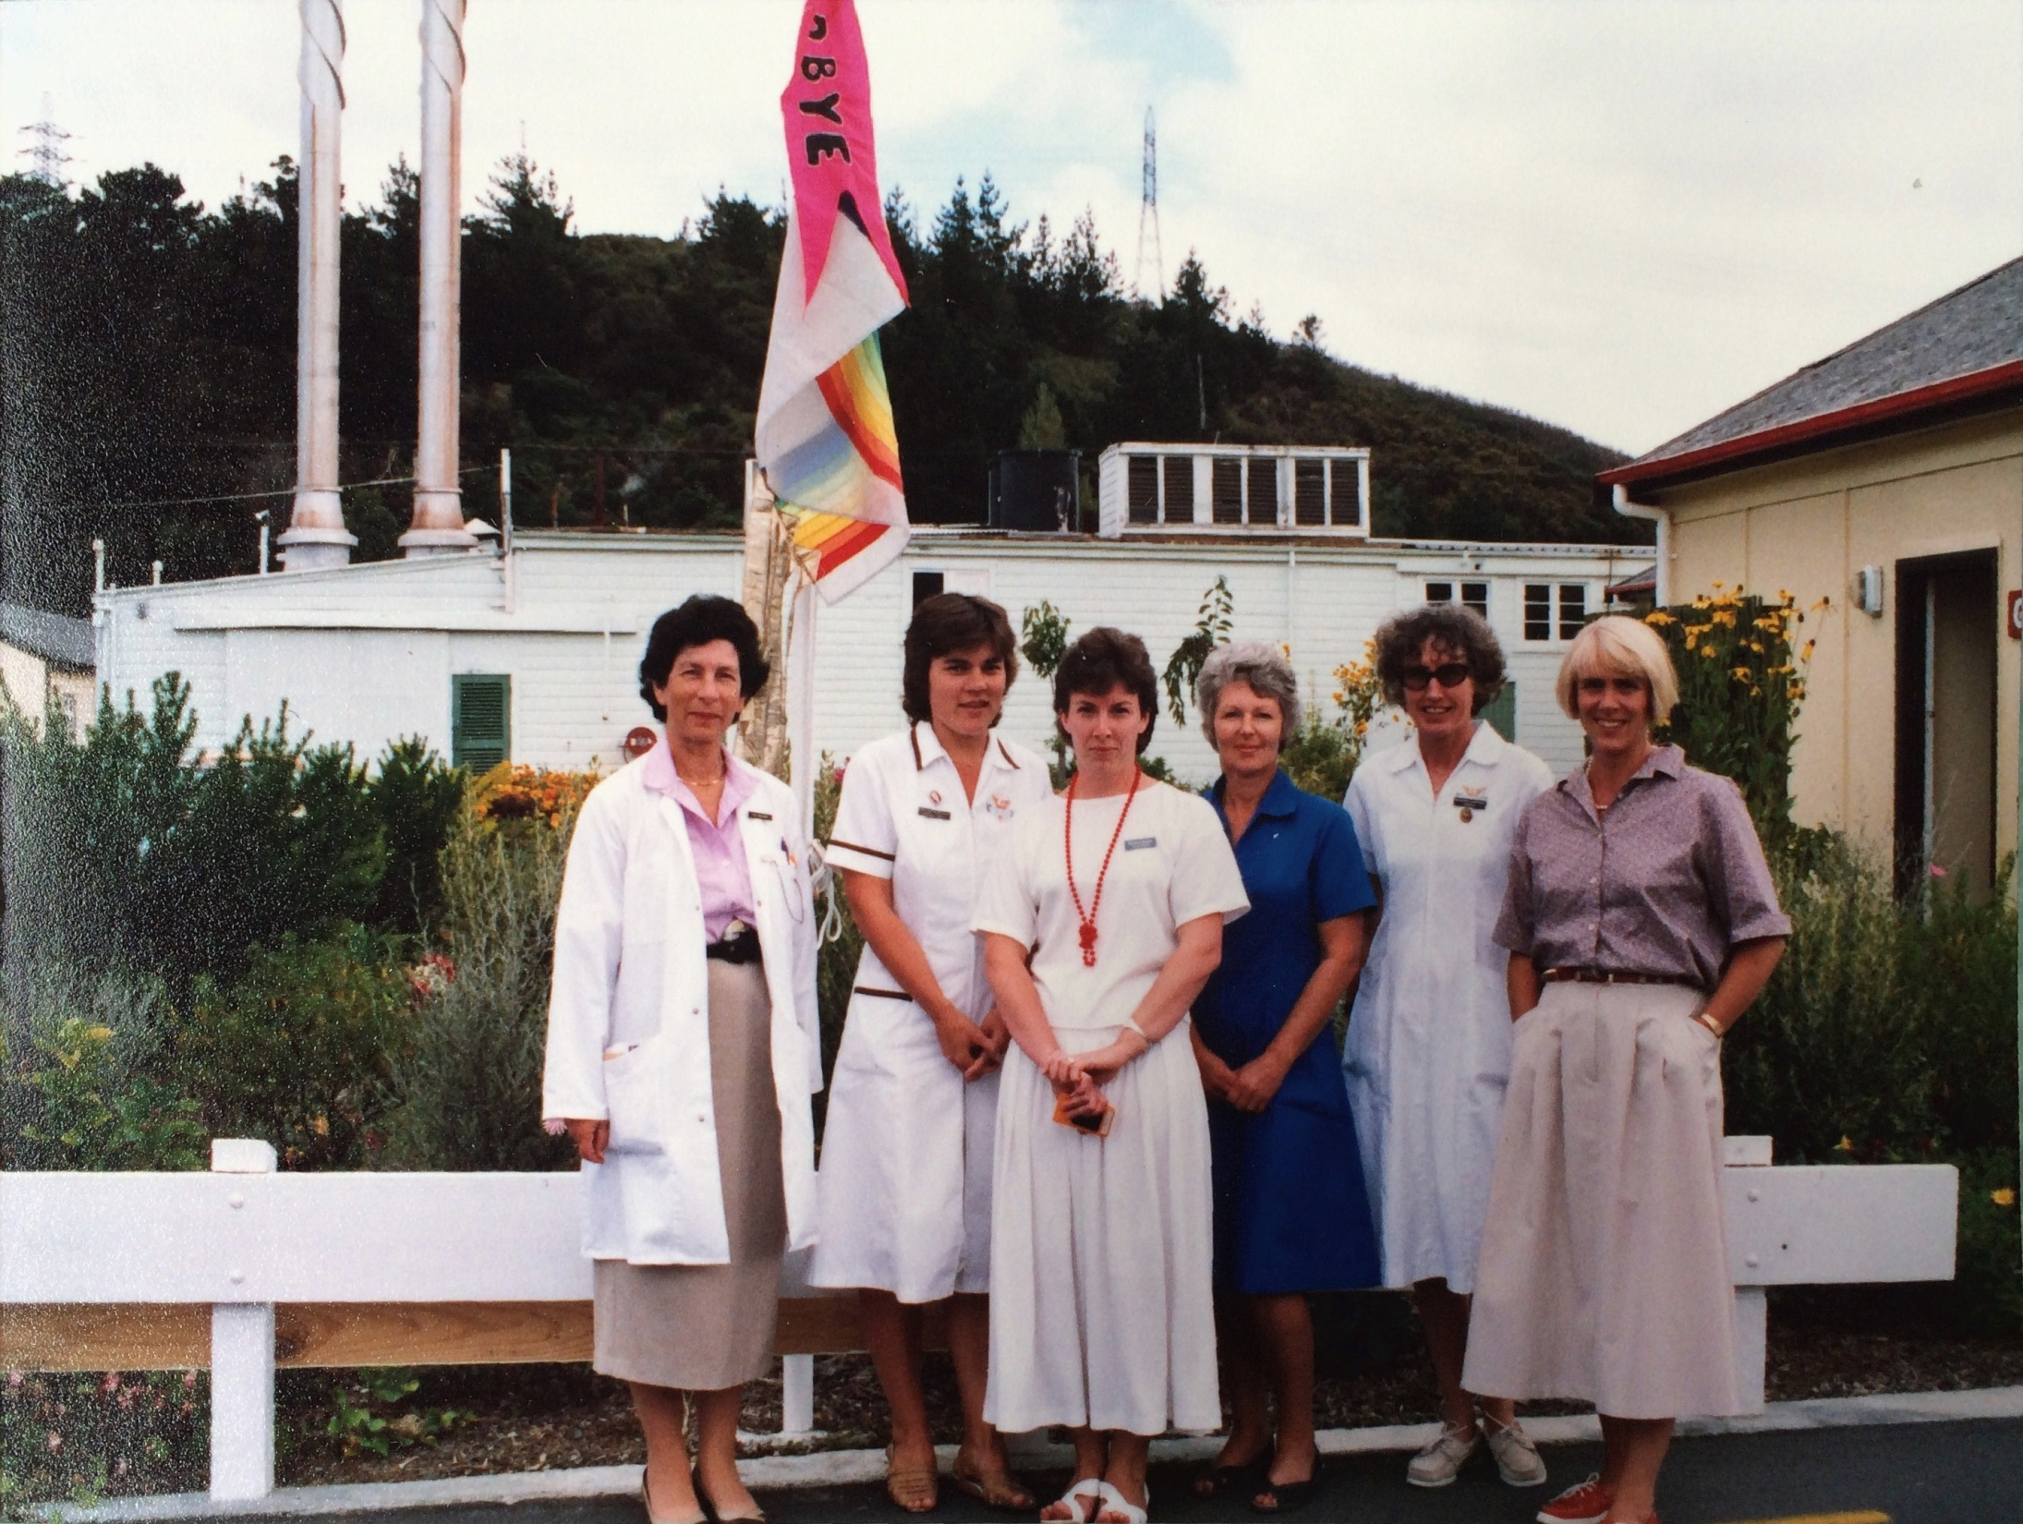

Slide 24
Team Members
Doctor
Nurse(s)
Physiotherapist
Occupational Therapist
Social Worker
Pharmacist
Dietitian
Others/ Family/Psychiatrist/Chaplain/Dentist/Winz/ACC

Slide 25
Legislation
Health and Disability Commission Act 1994 for Rights of Consumers
Health Practitioners Competence and Assurance Act 2003 to protect the Health and Safety of the public. It looked at registration of most of the health professionals.

Slide 26
